Slide 1

Data Related Job Posts in US
Data analysis, insights and recommendations

Slide 2
1 – INTRODUCTION
Title:
Data Analysis of job posts associated with data in US.
Objective:
To identify job post statistics in US, to put on a clear table which may help both appliers and the companies.
Data Source:
Kaggle - Data Job Postings

Slide 3

2 – OVERVIEW OF DATA
Number of observations
14,436
Variables included
'title', 'company_name', 'location', 'via', 'description', 'extensions', 'job_id', 'thumbnail', 'posted_at', 'schedule_type', 'work_from_home', 'salary', 'search_term', 'date_time', 'search_location', 'salary_pay', 'salary_rate', 'salary_avg', 'salary_min', 'salary_max', 'salary_hourly', 'salary_yearly', 'salary_standardized', 'description_tokens’
Data cleaning
Duplicates removed, missing values imputed or removed, column data types identified and corrected.

Slide 4

3 – DESCRIPTIVE ANALYSIS
Most Job Posts: Data Analyst
Least Job Posts: Data Warehouse Engineer
Most Job Posts (Platform): LinkedIn
Most Job Posts (Job Type): Full Time
Highest Salary: 322.400 $
Lowest Salary: 18.720 $
Most Job Posts (Seniority): Junior
Most Job Posts (State): Missouri

Slide 5

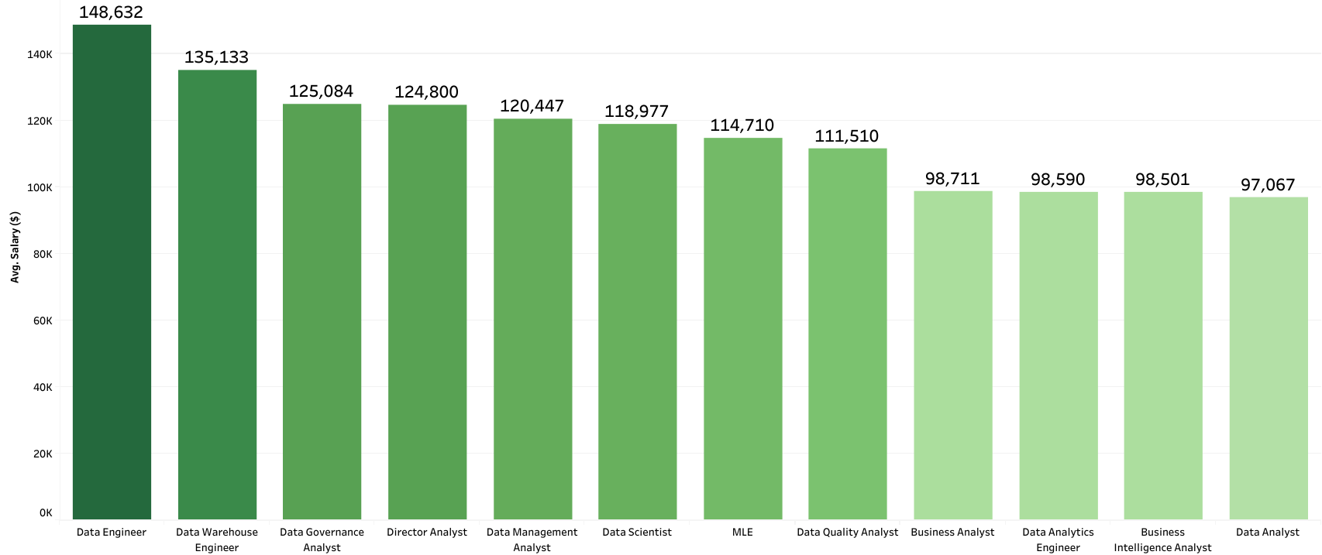
Average Salaries based on job titles
Highest Avg. Salary: 148.632 $ (Data Eng.)
Lowest Avg. Salary: 97.067 $ (Data An.)

Slide 6
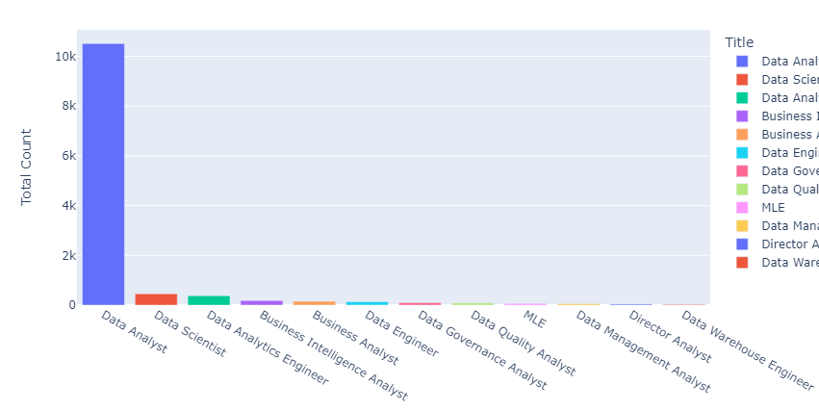

Number of Job Post by job titles

Slide 7
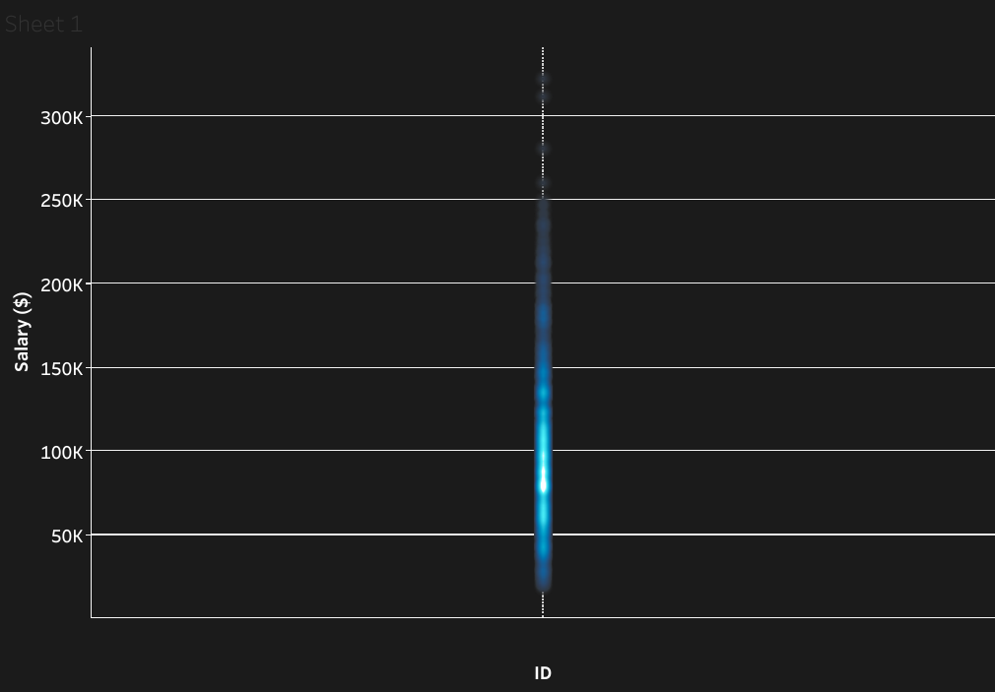
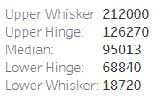

Salaries in the job posts
Max 322.400 $
Average 96.954 $
- Min 18.720 $

Slide 8

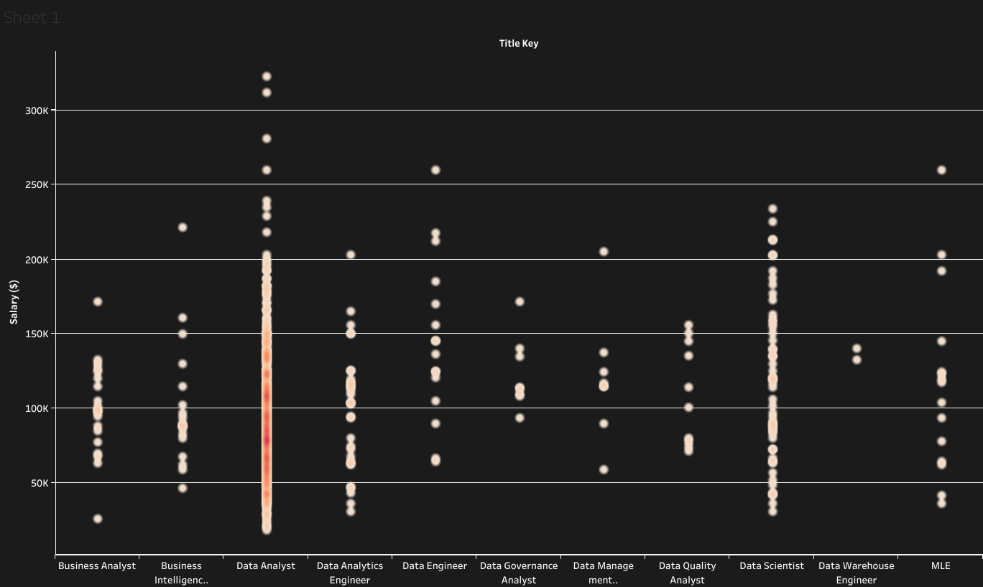
Salaries by the job titles

Slide 9
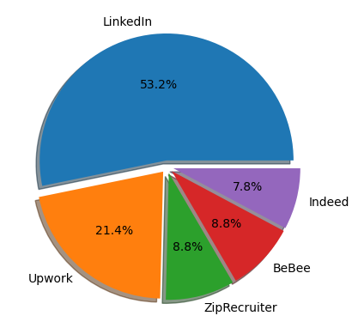

Top 5 Job Platforms
1 - LinkedIn 5059
2 – Upwork 2035
3 – ZipRecruiter 836
4 – BeBee 835
5 – Indeed 742
5059
742
2035
835
836

Slide 10
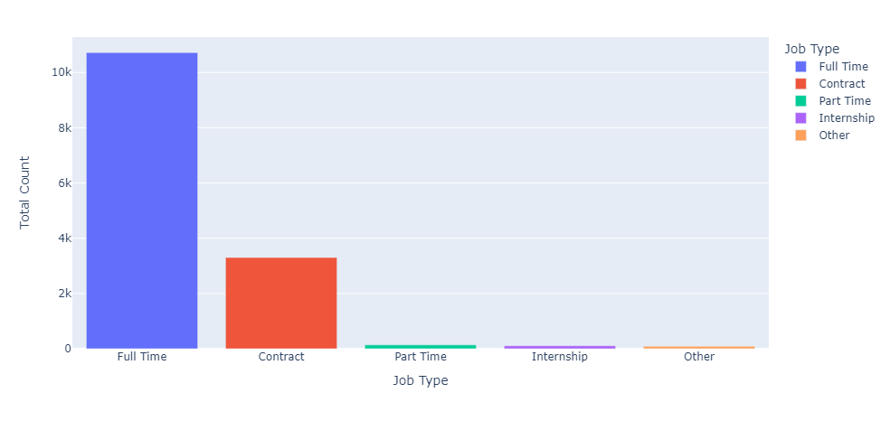
Schedule types of the job posts

Slide 11
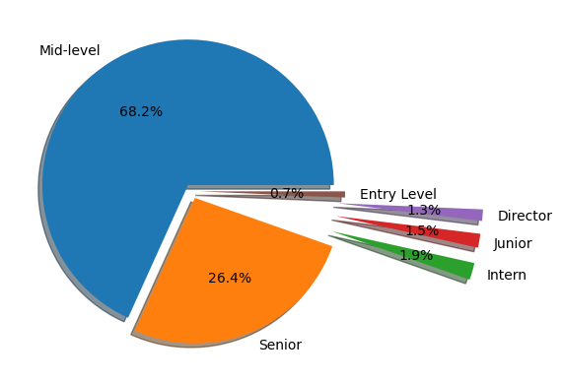
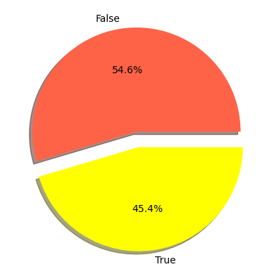
Percentage of job posts by seniority
Remote or not
Not Remote
Highest : Mid-Level
Remote
Lowest : Entry Level

Slide 12
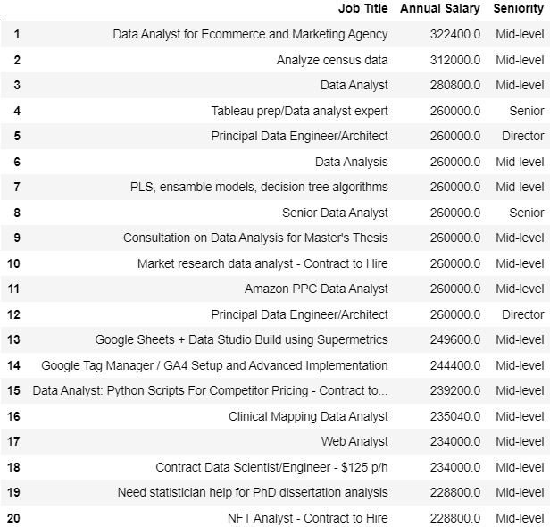
Top 20 Highest Salary in Job Postings
Highest : Data Analyst for E-Commerce and Marketing Agency
2/20 Director
2/20 Senior
16/20 Mid Level

Slide 13
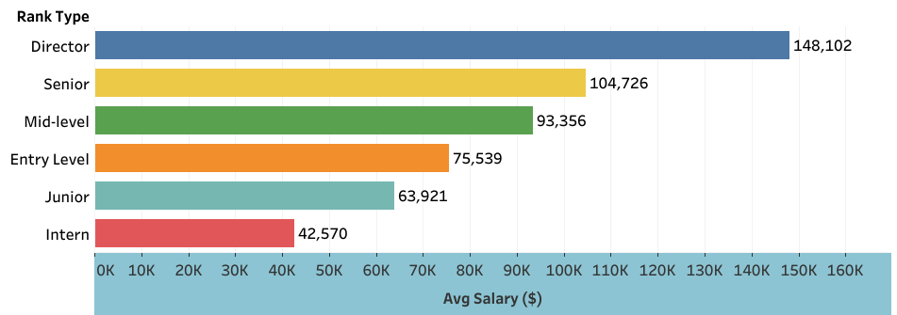
Average Salaries by Seniority

Slide 14
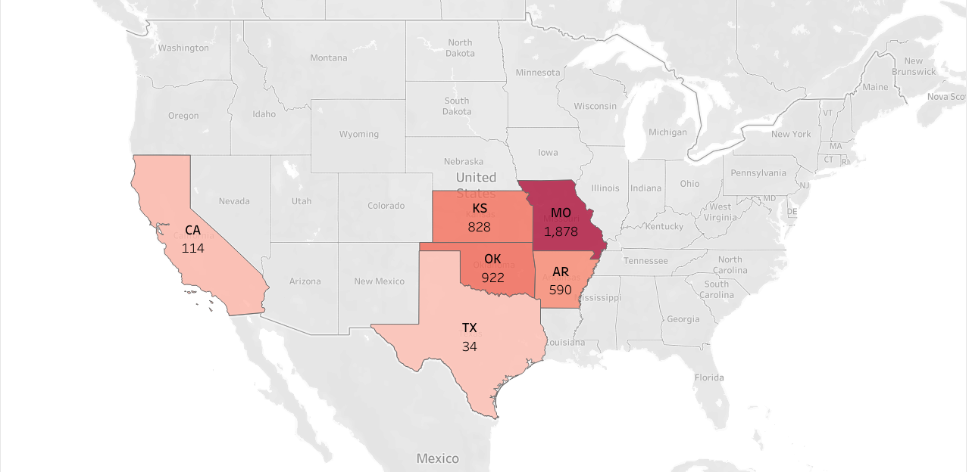
Most Job Posts based on states

Slide 15
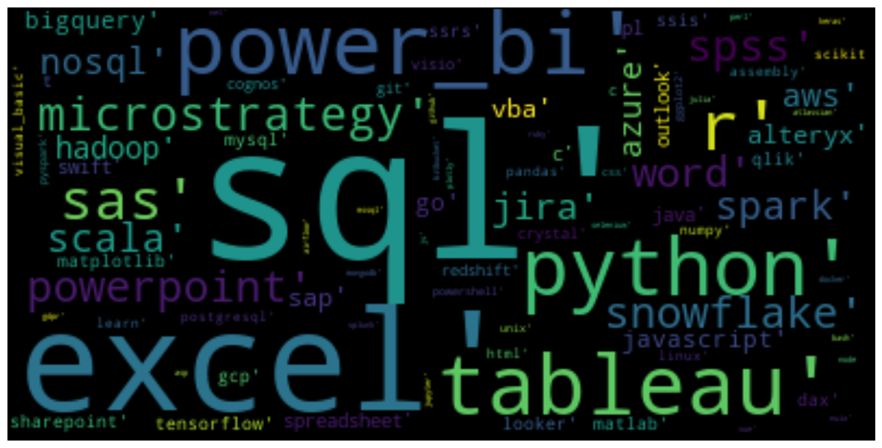
Which qualifications do employers demand most?

Slide 16
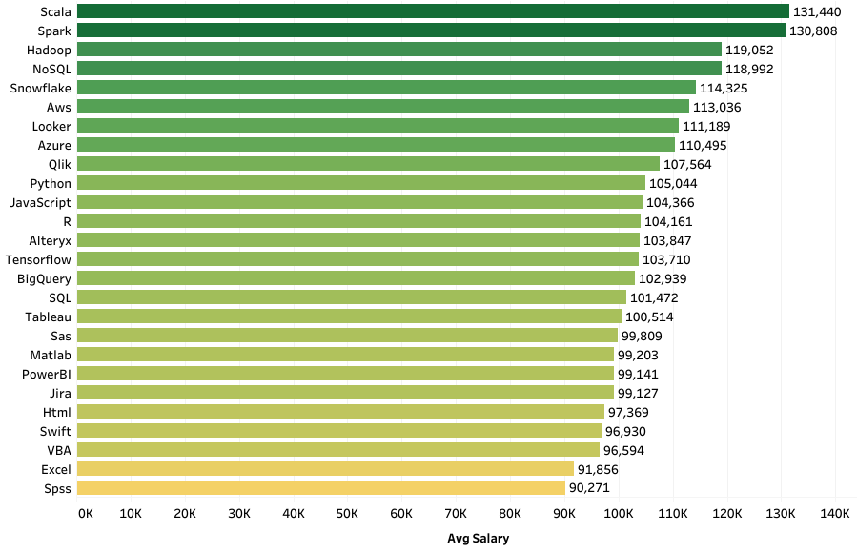
Salaries by required qualifications
Highest : Jobs require Scala
Lowest : Jobs require Spss

Slide 17
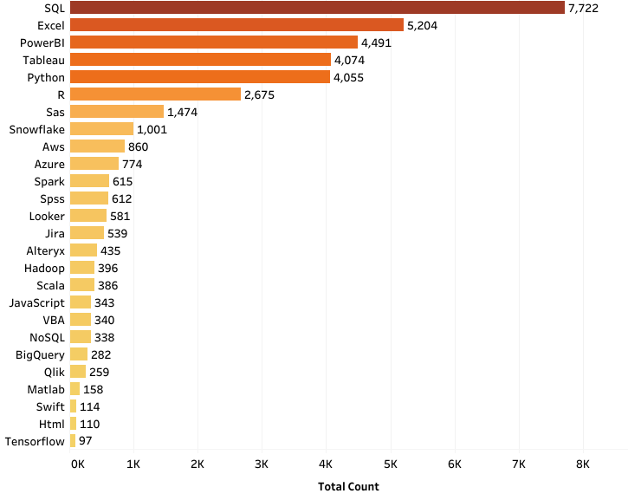
Number of jobs by required qualifications
Highest : Jobs require SQL
Lowest : Jobs require Tensorflow

Slide 18
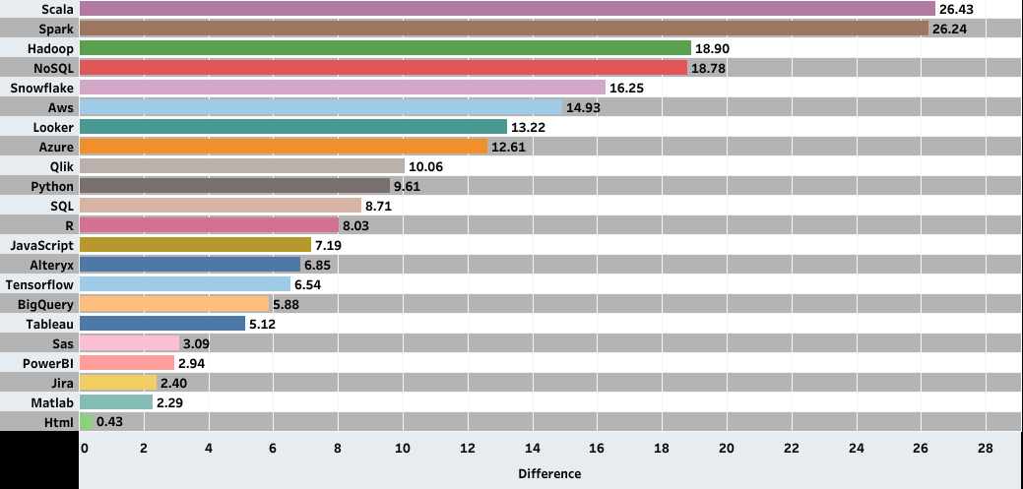
How much does being capable of a qualification increase the salary?
%
This graph shows the difference between the salaries which is presented in the job post, including and not including that qualification.

Slide 19

5 – INSIGHTS
SQL, Excel, PowerBI, Tableau, Python and R are very high in demand. Job seekers should consider improving these skills.
Highest salaries are given to people skilled in Scala, Spark, Hadoop and NoSQL.
Even the total number of job posts which require NoSQL skill is less than job posts require SQL skill, salary is higher by the job posts require NoSQL skill.
LinkedIn has more than half of the total job posts. It may be a good idea to check the job posts in LinkedIn.
State of Missouri has the highest count of job posts. (Info Reliability:Low)
Part time jobs and internships are a very little part of the total count. So delivering projects and gaining certificates are better ways to gain experience.

Slide 20
5 – INSIGHTS
Data Engineers are the highest salary group among the jobs related with data.
Although data engineers are the highest salary group, highest salary (322.400 $) is paid to a data analyst.
Data analyst job postings has the highest number of job postings by far.
Interns get paid an average of 42000 $ annually which is a good point for starters in data industry.
Mid level jobs may offer high salaries, even in some cases higher than jobs stated as senior and director jobs.
%45,4 of the job postings offer remote working option which has many advantages such as flexibility, increased productivity and cost savings.

Slide 21
6 – CONCLUSION
In conclusion,
By analyzing job postings data, we can gain a better understanding of the skills and qualifications that are most in demand in data related jobs, and use this information to make more informed hiring and career decisions.
I hope this presentation has been informative and has given you a better understanding of how job postings data can be used to gain insights into the labor market. Thank you for your attention.
While this analysis has some limitations, including the availability and quality of the data,
i believe that these recommendations provide a strong starting point for further exploration and
improvement.

